Slide 1


CEC SOCIAL MEDIA
101

Slide 2

Why follow and engage with CEC social media accounts?

Slide 3

Because, it affects you too!
What will your script be and how will you access it while you record?
Strengthens Employee Advocacy and Influence
Employees are often seen as more authentic and trustworthy than official corporate channels. Their engagement turns them into brand ambassadors, which can positively influence opinions and drive engagement, recruitment, and even sales through word-of-mouth marketing.
Boosts Brand Visibility and Credibility
When employees like, share, or comment on company posts, it amplifies the reach of the content to their personal networks. This organic engagement enhances brand awareness and signals to potential clients that the company has an engaged and supportive workforce, which builds trust and credibility.
Reinforces Company Culture and Values
Employee interaction on social media showcases a unified and active workplace culture. It gives the public—and potential recruits—a window into the company’s values, team dynamics, and internal pride, helping attract talent and customers aligned with the brand.
Will you insert questions into the video? How will learners share their answers?

Slide 4


So, how can you stay engaged?
Engage with us by liking, commenting, sharing, and following all our social media channels! The next slide will walk you through exactly how to get started.

Slide 5

It is HIGHLY recommended for all employees to have a LinkedIn account.

Slide 6
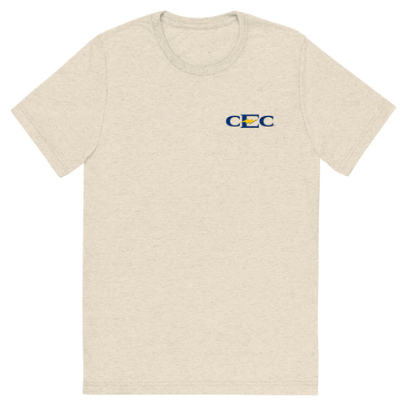


As part of our employee recognition efforts, we're offering any gift no more than 35 points through Awardco as a reward for anyone with proof of a LinkedIn account.
Value:
•35 points awarded for proof of LinkedIn
•(Note: 1 point = $1)
Examples of items 35 points and under:
For any questions regarding Awardco, please contact Chloe Scott. cscott@cecnrg.com

Slide 7


How to Create a LinkedIn Account
  Go to www.linkedin.com
  Click “Join now”
  Enter your email address and create a secure password
  Enter your name and click “Agree & Join”
  Add your location (country and zip code)
  Fill in your job title and CEC Energy as the company
  Verify your email using the code LinkedIn sends you
  Upload a profile photo (optional, but recommended)
  Follow the prompts to connect with people and build your profile

Slide 8

Instagram, Facebook, and X are not required, but strongly encouraged.
The following three slides provide guidance on how to create these accounts if you don't already have one. If you already possess an account, please refer to the instructions on slide 13 to proceed!

Slide 9


How to Create an Instagram Account
  Download the Instagram app from the App Store (iOS) or Google Play (Android); Or go to www.instagram.com on a computer)
  Tap “Sign up”
  Enter your email address or mobile number, then tap “Next”
  Create a username and password
  Enter your full name (optional)
  Add a profile photo (optional but encouraged)
  Tap “Sign up” to complete your account
  Follow people or skip to go straight to your new profile

Slide 10


How to Create a Facebook Account
  Go to www.facebook.com (Or download the Facebook app on your phone)
  Click “Create new account”
  Enter your name, mobile number or email, password, birthday, and gender
  Click “Sign Up”
  Verify your email or phone number with the code Facebook sends you
  Add a profile photo (optional, but recommended)
  Start adding friends or explore your new profile

Slide 11


How to Create an X (Twitter) Account
  Go to www.x.com (or download the X app)
  Click “Sign up”
  Enter your name, phone number or email, and date of birth
  Click “Next” and review customization options
  Click “Sign up” again and verify your email or phone with the code sent to you
  Create a password
  Choose a username (handle) or use the one suggested
  Add a profile photo and bio (optional, but helps personalize your account)
  Follow topics or accounts to start building your feed

Slide 12




Top social media contributors across all platforms will also be awarded.
  Recognition occurs quarterly
  The top 5 employees with the most impactful social media engagement will be selected and put in a drawing to win 150 points. The other 4 remaining employees not drawn will be awarded 50 points.
Examples of items for 150 points:
Examples of items for 50 points:
For any questions regarding Awardco, please contact Chloe Scott. cscott@cecnrg.com

Slide 13

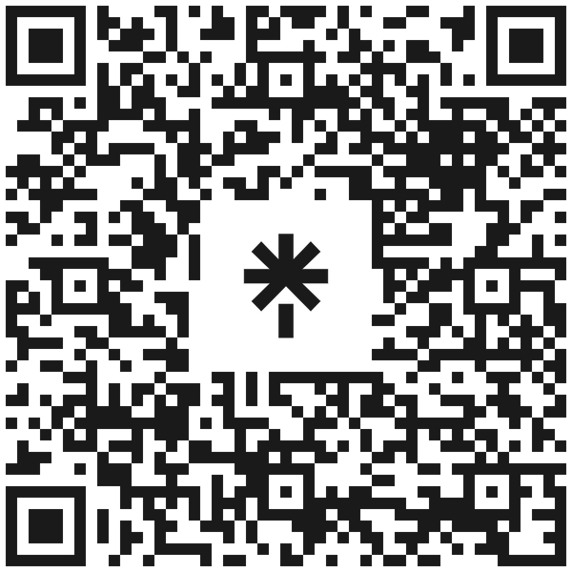
All that’s left, is to follow and engage with our socials!
The QR code below will direct you to a link featuring all of our social media accounts.

Slide 14

Thank you for striving to be the best everyday!
Please contact Alexa with any questions you may have!
aakers@cecnrg.com
361-677-2703
Marketing & Communications Specialist

